Slide 1
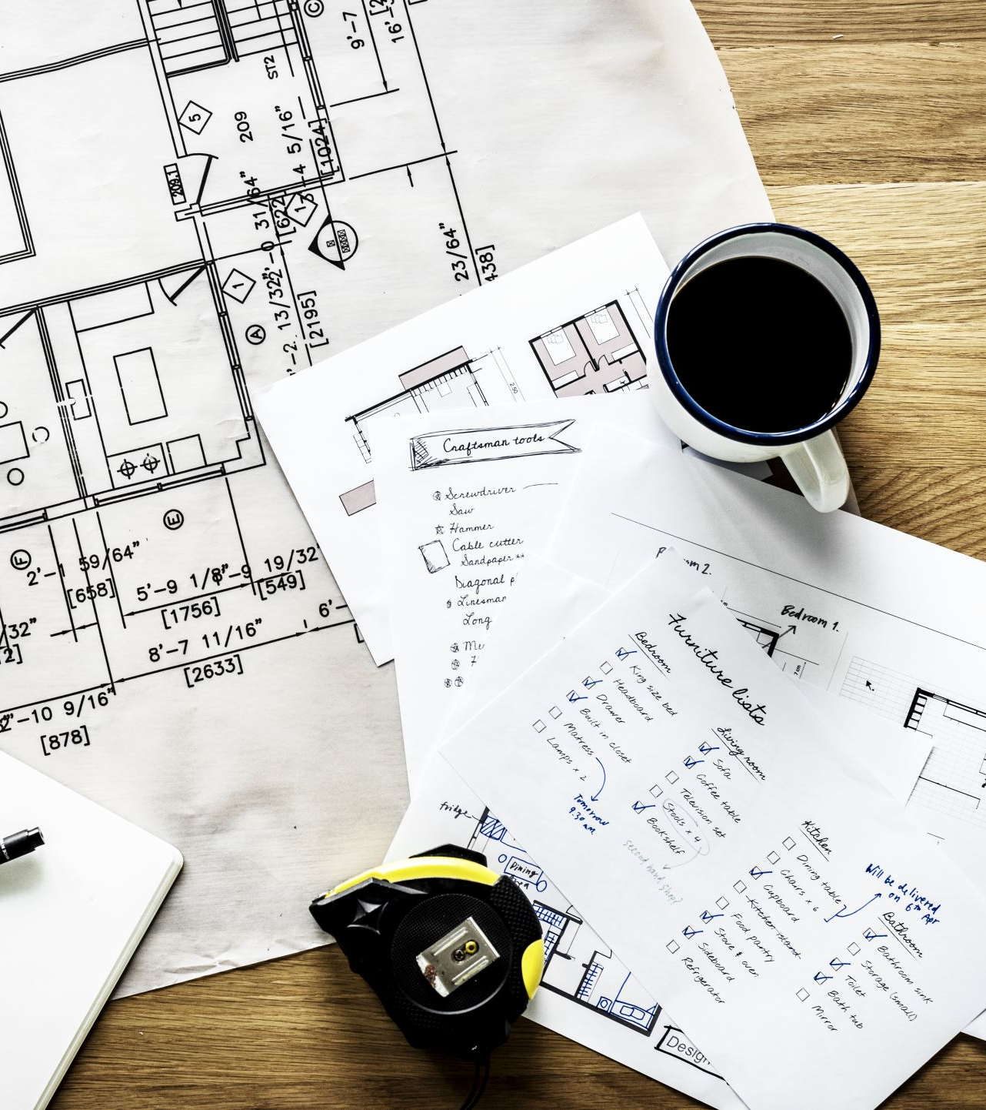
Earlham 2040 Comprehensive Plan
Community Meeting
Community Center
Thursday, October 19, 2022

Slide 2
Agenda
What is the plan?
Earlham today
Earlham in 2040

Slide 3


Comprehensive plan
High level
Comprehensive
Vision-focused
Land-use oriented

Slide 4
Community Character
Earlham is a quiet and tight-knit town where the values of community are strong. The people are proud of the community and seek to preserve its good character while allowing for some growth consistent with its prominent location. History, culture, education, and a good standard of living are all key values of this character.
Interesting historic buildings and the cool restored Bricker-Price Block are foundations for tourism and community activities in the future. Adding wayfinding, walkability, and beautification between them will add value.
Concepts mentioned by stakeholders:
  Sense of history and pride in what makes Earlham unique, not just another suburb.
  Strong public school system.
  Embracing the “bedroom community” identity but with much more.
  A self-sustainable community.
  Unity and togetherness.
  Multi-generations of families living in the community.

Slide 5
Community Character

Slide 6
Community Character
North entry to city is attractive, but other entries are non-distinct.
Signs are lacking on I-35 near Exit 104 (and 106).
Earlham does not promote its proximity to the covered bridges.

Slide 7
Physical Character
Expanses of prime farmland
Proximity to the Interstate and Des Moines
Access to railroad
Extensive natural resources (and potential for more)
  Agri-tourism north of the city/I-80
  Reclaimed mining areas could be recreation in collaboration with county conservation or other entities
Topography and soils suitable for development in all directions

Slide 8
Demographics

Slide 9
Demographics
Median age approximately the same as statewide
97% white
Slightly more educated
More likely to be in a family relationship
More likely to be homeowners
Median income higher than statewide and much higher than rural Iowa

Slide 10
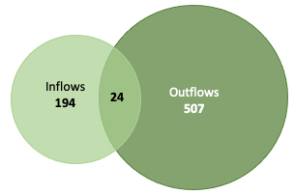
Economy - Workforce
Most work in “white” collar employment
Identified shortage of “blue” collar technical workers – plumbers, electricians, auto mechanics, etc.
Heavy commuting outflows
Mean travel time to work is about 24 minutes
Few employers in the city

Slide 11
Economy – Sales
Slow decline until about four years ago. Since then a rebound/growth
Retail sales outperforming rural peer cities that are near metros but remain below the expected sales levels

Slide 12
Downtown
People believe the downtown is relevant, that design standards should be created and adopted to guide redevelopment, Earlham should prohibit main-floor storefront residential uses, and downtown needs more retail options. Upper story housing and street trees/foliage are also identified needs of a lesser level. A master planning committee is also reasonably popular.

Slide 13
Economic Needs

Slide 14
Housing – Physical Conditions
Many older homes remain but considerable number were built from 2000 to 2009
Few since then
Many vacant 1970s units (likely mobile homes)
Lack of rentals
Few multi-family structures
Overall high quality - not many deteriorated

Slide 15
Housing - Affordability
Well over half of the homes cost more than $150,000
Unaffordable for many of the jobs located in Earlham – evidence of “gentrification.”
Rental housing is comparably more affordable when compared to rural Iowa, but a higher percentage of renters are cost burdened.

Slide 16
Housing Needs

Slide 17
Community Facilities
Brief analysis is performed on community facilities:
  Library, city hall, community center, cemetery, public works building, etc.
Focus is on proposed future needs for facilities, staffing, and equipment.
Overall, city is meeting basic demands and will continue to do so.

Slide 18
Recreation
Earlham has three main recreational areas
  City Park
  Athletic complex (some shared with school) and swimming pool
  Gendler Park
Combined, these meet the recognized need in terms of total acres of parkland.
Variety of recreational options may be limited – consistent with a small community
There is little or no directional signage to tell people where recreation can be found.
Gendler Park is far from meeting its potential

Slide 19
Facility and Recreational Needs

Slide 20
Transportation
12+ miles of roadway in the city.
Roads overall in good condition, largely due to recent improvements.
Ten-year old capital improvements plan calls for road extensions in most/all directions from the city, which would accommodate growth.

Slide 21
Walkability
Sidewalk program bearing fruit.
Few missing or poor condition sidewalks
Wider sidewalks near school
No continental crossings and limited signage
No established trails

Slide 22
Transportation Needs

Slide 23
Public Infrastructure
Modern infrastructure, but there are considerable water and sewer main improvements planned as funding is available.
Capacity may need to grow to support extensive new development.
As is typical to rural small towns, storm water infrastructure is limited.
Planning must consider the difference in standards and levels of service in rural areas around town if the city may eventually annex it. Fortunately, Madison and Dallas County have development standards and rural zoning, etc.

Slide 24
Infrastructure Needs

Slide 25
Land Use Composition
The largest land use categories, those occupying the most land, are single-unit residential (28%), transportation and utilities (26%), and agriculture (27%)
Limited higher density residential uses
Few vacant lots for a town so close to the metro
Agricultural land may be owned by unwilling sellers

Slide 26
Land Use Distribution
Pattern is typical for a community of this size and location.
Allows for growth within the city, if landowners are willing to sell.

Slide 27
Rural Land Use Composition
Like Earlham proper, the planning area is mostly flat with some rolling hills dissected by small steams. Most of the area is used for row crop production.
Mostly agriculture.
500+- residents
Subdivisions near/north of I-80

Slide 28
Rural Land Use Distribution
Many planning areas surrounding rural cities have few other uses, but this area includes commercial, mining/extraction operations, recreation and other uses. This is indicative of an area poised for growth.

Slide 29
Fiscal Condition
Moderate tax rates compared to peers.
Growing property tax basis.
Unexplained drop in most recent year reported.

Slide 30
Population Projection and Prediction
Projection average:
  2030: 1541
  2040: 1586
Prediction:
  2030: 1600
  2040: 1800
Prediction includes some regional growth is located in Earlham

Slide 31
Future Land Use Needs
Shortage of approximately 210 housing units
Shortage of local commercial and industrial land, but can be met by redevelopment or repurposing properties
Infrastructure capacity, generally, is adequate
About 5,000 SF of total City-owned public facility space may be needed
Recreational space needs should be met with existing areas
Approximately 1 FTE staff would need to be added

Slide 32
Rural Development Area
New acres are needed to support growth, probably 100 acres total. Most could occur in the city, but market choices mean that rural development should also be planned for.
Map shows areas that should be considered for potential growth, not necessarily annexation.

Slide 33
How Do We Get There
Future planning elements
Implementation strategies
Future land use map for city and planning area

Slide 34
Vision Statement Exercise
Earlham will grow to nearly 2000 people in a sustainable way that enhances its community character that is based on a strong sense of togetherness and that grows the local economy in a balanced way that ensures an affordable living.
Get in tables/groups of three or more people
Take the packet provided and organize them into a mock vision statement describing the ideal Earlham in 2040
When ready, each team will read their statement.
Discussion will follow about what should be the statement for the plan.
That statement will guide the planning recommendations to be created and presented for City approval in the final document.

Slide 35
Guiding Principles
Create five to eight “guiding principles.”
The guiding principles are meant to highlight the principles and values that should be the aim of all decision-making in a community.
Winterset’s new plan has the following:
  Welcoming committee
  Economic growth + development
  Quality of life
  Resiliency
  Mobility + connectivity
  Parks & recreation
  Neighborhood development

Slide 36
Future Needs and Priorities
See handout.
Each person answer the following questions about guiding principles, opportunities, and priorities
This data will help shape the goals and actions sections of the plan.
Turn in when complete.

Slide 37
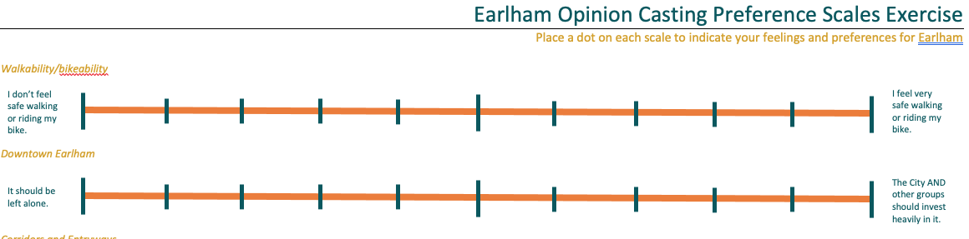
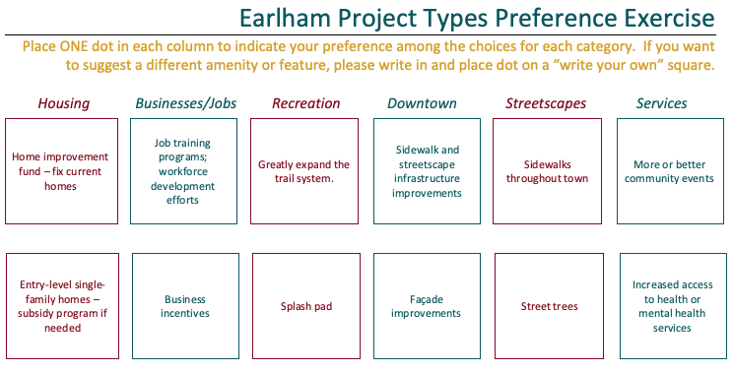
Rating Scale and Project Preference Exercises
Take a few minutes
Three copies of each page, so each person is to look at one copy and respond
Each person take some stickers from your table
Three total pages

Slide 38
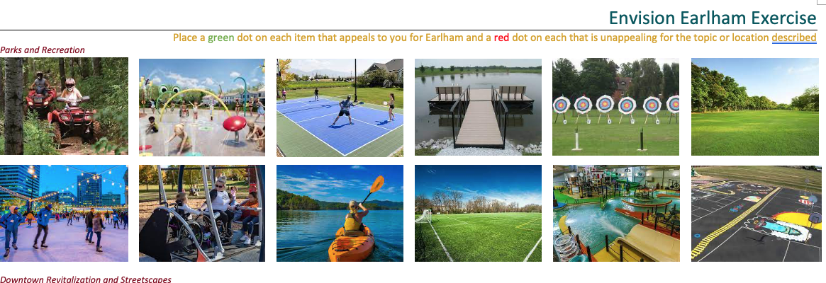
Picture Preference Exercise
Take a few minutes
Three copies of each page, so each person is to look at one copy and respond
Each person take some stickers from your table
Green stickers on all the photos that would be appealing in your opinion for Earlham
Red stickers on all that are unappealing for Earlham
Two total pages

Slide 39
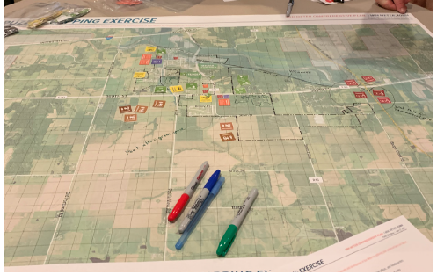
Mapping Exercise
Take a few minutes
Three copies of two maps, so please approach one pair of them. Place stickers and/or notes describing where you want activity to occur, such as more industry, more single-family housing, more apartments, a park, a trail, etc.
Comment on what you want to see at Gendler Park in 2040.

Slide 40
Next steps
Compile today’s session information
Draft future development chapters
Prepare an implementation chapter
Final stakeholder meeting
Incorporate comments from stakeholders into draft plan
Publicize draft plan for comments
Planning and zoning commission review
City council review
Adoption

Slide 41
Contact
Jeremy Rounds, Regional Planner
Terry Niestadt, Regional Planner
SICOG
641-782-8491
rounds@sicog.com or niestadt@sicog.com
www.sicog.com
THANK YOU!!!

